Slide 1
DIGITAL PORTFOLIO
Student Information
Student Name: N. KRITHIKA.
Registration Number and NMID: astvu346m24384.
Department: B.C.A COMPUTER APPLICATION.
College/University: M.M.E.S. Women’s Arts and Sciences College.

Slide 2
Interactive digital portfolio

Slide 3
PROBLEM STATEMENT
PROJECT OVERVIEW
END USERS
TOOLS ANDTECHNOLOGIES
PORTFOLIODESIGN AND LAYOUT
FEATURES ANDFUNCTIONALITY
RESULTS AND SCREENSHOT
CONCLUSION
GITHUB LINK

Slide 4
PROBLEM STATEMENT
In today’s digital era, traditional resumes alone are not enough to showcases kills and project effectively. Many students and professionals lack a structured online presence to highlight their work. A Digital portfolio provides an interactive and accessible platform to present achievement, skills and experience .

Slide 5
PROJECT OVERVIEW
Brief summary of my project.
What my portfolio contains(about me, projects, skills, contact).
Main idea: showcase personal achievement, skills, and projects.

Slide 6
WHO ARE THE END USERS?
Students (academicprojects,resumes).
Job seekers (to share with recruiters).
Freelancers (to show clients).
Professionals(to highlight experience and achievements).

Slide 7
TOOLS ANDTECHNIQUES
Html: structure (pages, sections).
CSS: styling (colors, layouts, responsiveness).
JavaScript: interactively(navigation menu, animation, from validation).
Mention code editor (VS code)or CODEPEN and hosting platform (GitHub pages).

Slide 8
PORTFOLIO DESIGN AND LAYOUT
Sections included: Home/about me Projects Skills Contact Responsive layout(mobile+desktopview).

Slide 9
FEATURES AND FUNCTIONALITY
Navigation bar with smooth scrolling. Project showcase with images/details. Interactive elements (hover effects, animation). Contact form (with validation).

Slide 10
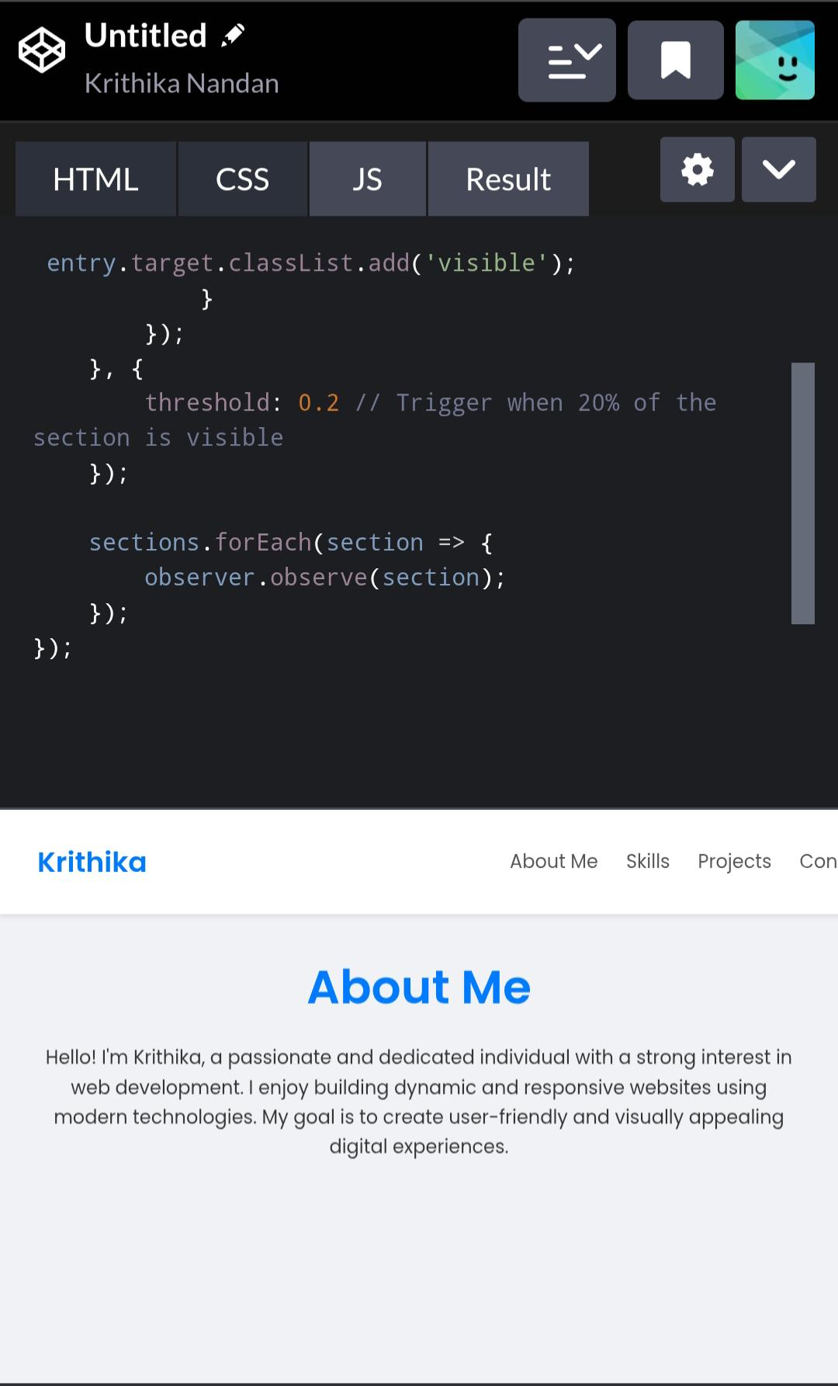
RESULT AND SCREENSHOT
Screenshots of each section Before vs after(plain HTML: with CSS&JS).

Slide 11
CONCLUSION
Highlights of my project Final summary.
Benefits of society.

Slide 12
THANK YOU

